Slide 1

Auth in Web Apps

Slide 2
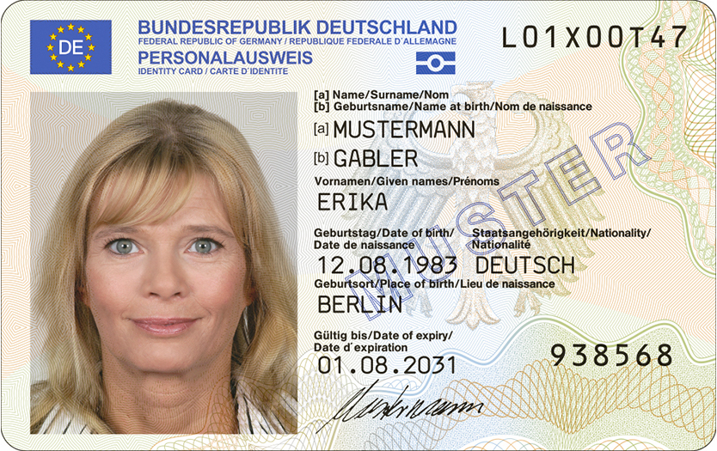
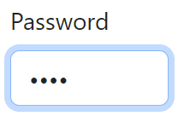

Identification vs. Authentication vs. Authorization: Knowing the differences
Identification
Authentication
Authorization
Legitimacy checks KYC procedures
Confidence, fight against fraud and money laundering
Privacy and data breach concerns
Knowledge-, Possession-, Inherence-based 1FA, MFA, SSO
Quicker process, less intrusive, cost-effective
Risk of impersonation, limited fraud detection
RBAC, ABAC, ReBAC, PBAC, Multi-party Authorization
Works in conjunction with authentication
(Ex.) The customer provides legally secure proof of their identity to the bank.
(Ex.) The bank verifies that an individual accessing its services is still the same legitimate account holder.
(Ex.) The bank determines what services and resources a verified customer is permitted to access.
https://commons.wikimedia.org/wiki/File:Deutscher_Personalausweis_(2021_Version).jpg
https://oauth.net/images/oauth-logo-square.png

Slide 3

Part 1: Authentication

Slide 4
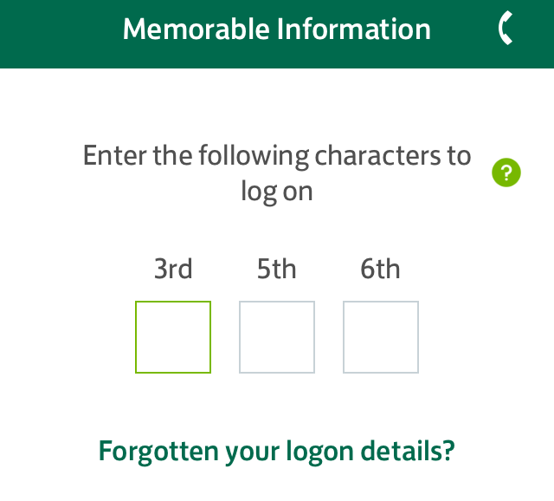
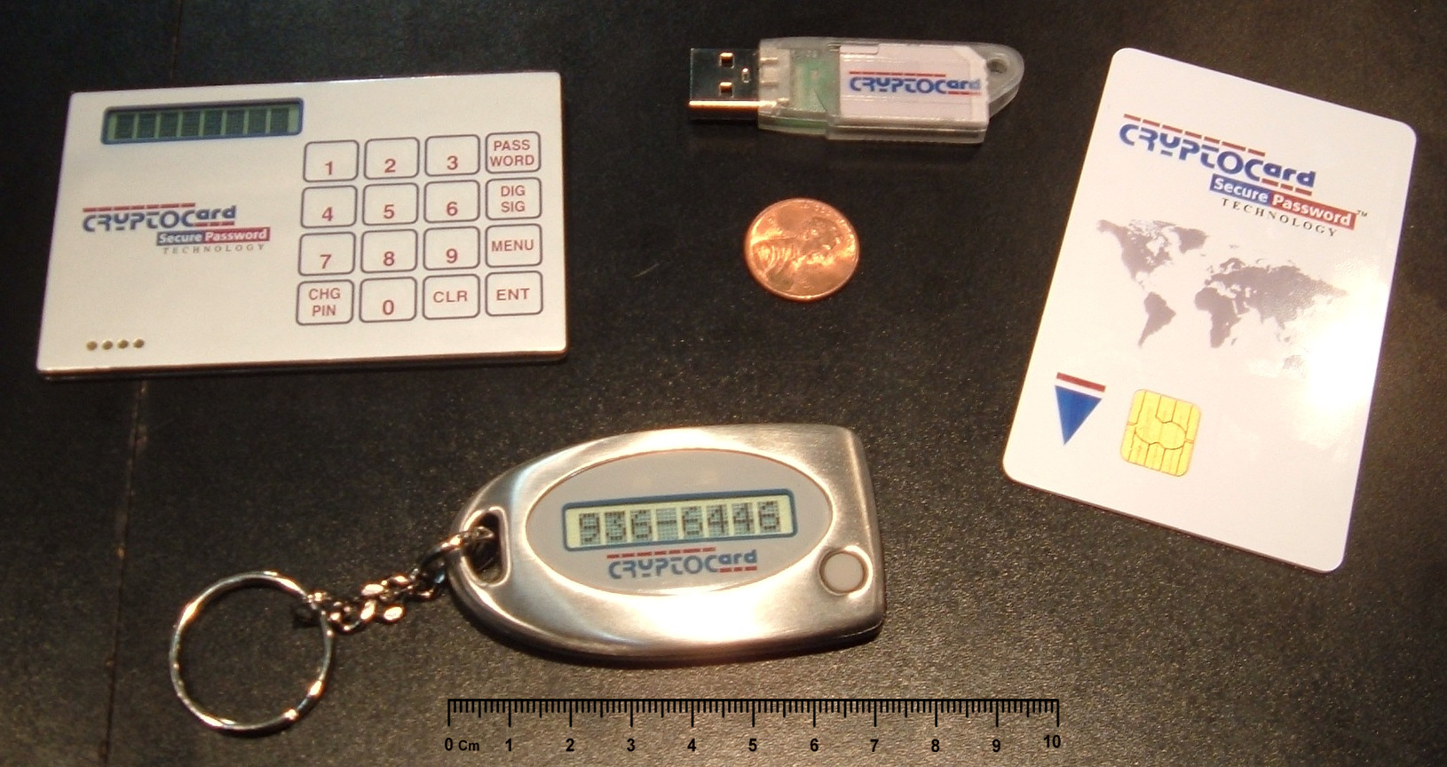

A practical overview of authentication methods
Knowledge Secrets
Possession Ownership
Inherence Biometric
Challenge Response (CRAM)
OTP
Partial Password
Passphrase
Password
Pattern
Personally Identifiable Information (PII)
PIN
Security Question
ID card
Implant
Smartcard
Smartphone
App
Phone Call
SMS
Smartwatch
Security Token
NFC
Software
USB
Wrist band
Brain waves
Breath
DNA sequence
Face
Fingerprint / Handprint
Gait (movement)
Iris / Retina
Keystroke dynamics
Signature
Voice
https://en.wikipedia.org/wiki/File:Partial_password_entry_form.png
https://commons.wikimedia.org/wiki/File:SecurityTokens.CryptoCard.agr.jpg
https://commons.wikimedia.org/wiki/File:Teerahertz_near-field_array_for_%CE%BCm-scale_surface_imaging_(cropped).png

Slide 5
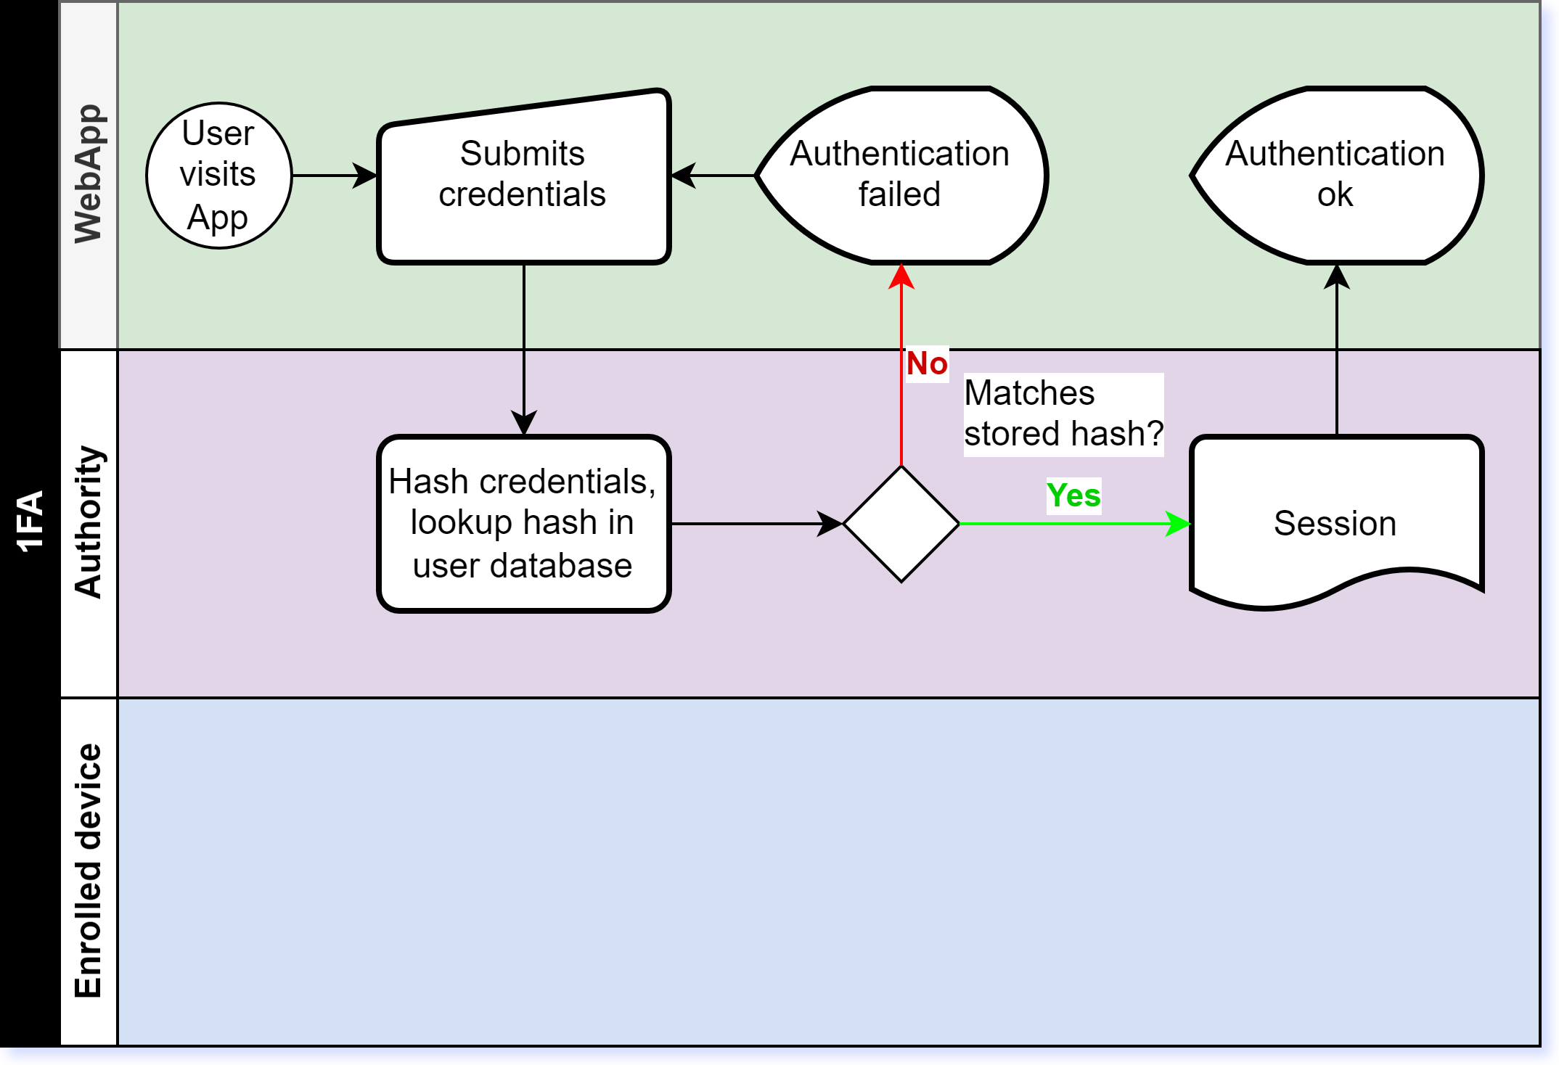
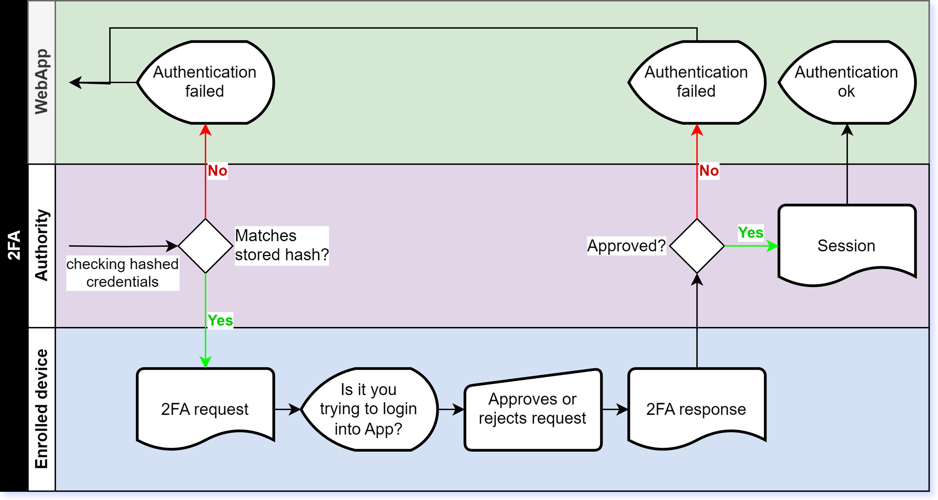
1FA vs MFA: Mitigating phishing attacks.
1FA Asks for only one factor to verify identity claim.
MFA Requires authentication on additional factors.

Slide 6
Keep your secrets: Transport-layer encryption leaks to SSL/TLS termination proxies.
Encrypt payloads containing secrets with public-key cryptography in client before transfer.
Include variable part in the payload, ex. nonce or timestamp, to prevent dictionary attacks.
Only authorized receivers knowing the private key can read the payload containing the secret.
Or if applicable, use a Zero-Knowledge Password Protocol.

Slide 7
Implementing authentication with Identity and Access Management platforms.
 | Keycloak | ForgeRock or PingIdentity | Auth0 (Okta)
Solution type | Open Source | Proprietary | Proprietary
Deployment model | Self hosted | Self hosted or Managed | Managed
Login and self services | Integrated app Customizable | Integrated app Customizable Configuration “Custom login” as redirect to custom app. | Integrated app Supports HTML templates, which enables loading custom app resources.
Behavior model | Linear Configurable flows and steps | Directed trees Configurable nodes Custom node implementations | Pipeline for modifying behavior Configurable actions Actions as custom functions

Slide 8
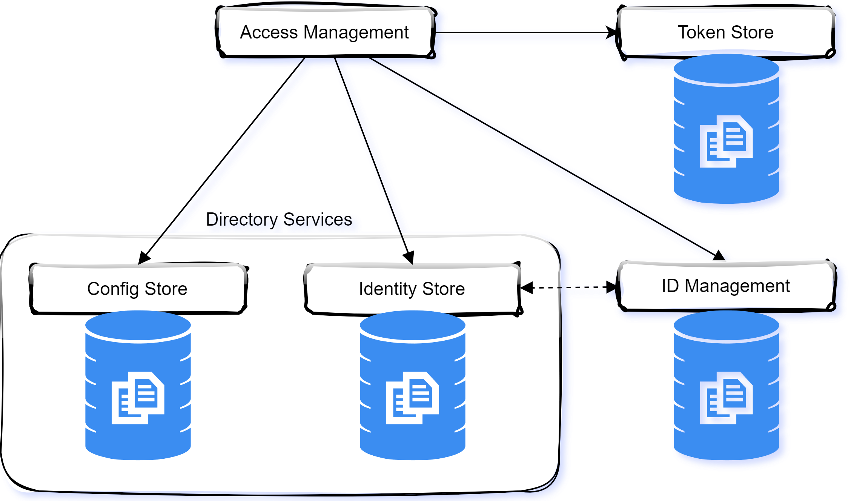
A simplified view on a IAM system architecture.

Slide 9

Part 2: Authorization

Slide 10
Permitting access: From role-models to
Early methods: Simple user roles and hard-coded permissions.
Development of role-based access control (RBAC).
Modern approaches: Attribute-based access control (ABAC) and policy-based access control (PBAC).
RBAC, ABAC, ReBAC, PBAC, Multi-party Authorization

Slide 11
Modelling authorization in a bank

Slide 12

Part 3: Delegated authorization

Slide 13
Get Introduced to OAuth 2.0 and Its Components
Introduction to OAuth 2.0: What It Is and How It Works
OAuth 2.0 overview: Authorization framework, not an authentication protocol.
Key components: Resource owner, client, resource server, and authorization server.
How OAuth 2.0 improves security and user experience.

Slide 14
Learn How to Implement OAuth 2.0 in Web Applications
Implementing OAuth 2.0: Steps and Considerations
Different grant types: Authorization code, implicit, password, and client credentials.
Securing OAuth 2.0 tokens and handling token expiration.
Real-world examples and best practices for implementation.

Slide 15
Conclude with Key Takeaways on OAuth 2.0 and Security
Key Takeaways and Future Considerations for Web Security
Summary of the benefits of using OAuth 2.0.
Future trends in authentication and authorization.
Encouraging continuous learning and adaptation to new security threats.

